Slide 1
Artificial Intelligence (19Z503) Introduction
Course Faculty
Dr.D.Indumathi
Associate Professor
Dept. of CSE
PSG Tech

Slide 2
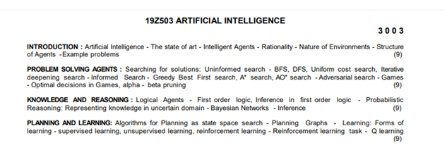
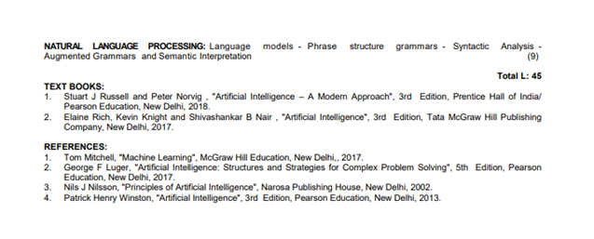

Slide 3
Syllabus
COURSE OUTCOMES:
Upon completion of this course, the students will be able to
CO1: Apply the fundamental AI concepts to represent and solve real-world problems
CO2: Analyze and solve AI problems using heuristic, non-heuristic and adversarial search strategies
CO3: Employ knowledge representation, logical reasoning and statistical methods to solve AI problems
CO4: Apply planning and learning concepts to solve AI problems
CO5: Apply NLP concepts to analyse and solve real-world problems

Slide 4
Introduction
What do we call ourselves? Homo sapiens—man the wise
Our intelligence is so important to us (Cogito ergo sum –” I think, therefore I am” by Rene Descartes)
For millennia mankind wanted to understand how we think
How human brain can __ a world far larger and more complicated than itself?
perceive,
understand,
predict,
and manipulate
The field of Artificial Intelligence attempts to understand and also to build intelligent entities

Slide 5
Intelligence
What is intelligence?
Examples
Mathematician, Painter, Artist, Musician, Chess player, ???
Formal tasks: Chess playing, theorem proving, …
Generic problem solving?
Learning?

Slide 6
Intelligence – characteristics?
Thought process and reasoning (Thinking!)?
Behaviour (Acting!)?
Measured against
Human performance?
Defined ideal / rational performance?
Human centred approach
Empirical approach (observations and hypotheses of human behaviour)
Rational approach
Mathematics and Engineering (formal, problem solving)

Slide 7
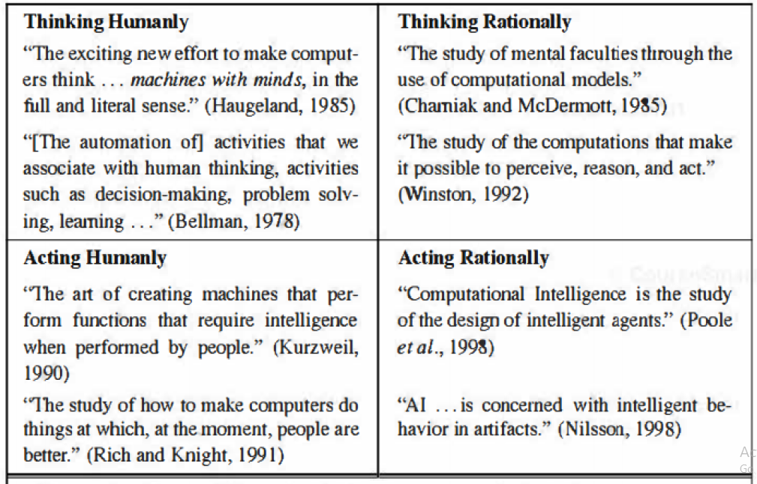
What is AI?
Thought processes and reasoning
Behaviour
Measure success in terms of fidelity to human performance
Measure against an ideal performance measure (rationality)

Slide 8
Acting humanly: Turing test
On one side a questioner, On the other side (hidden) a computer / a human
Who answers questions?
If questioner cannot find out, computer passes test
Addresses all major concerns of AI
Natural language processing, Knowledge representation, Automated reasoning, Adaptive machine learning
Total Turing test
Add Perception, Object manipulation
Computer vision, Robotics

Slide 9
Acting humanly
Is Turing test a good test?
Imitating human / utilize underlying principle
Think of flying (another difficult task)
All bird-like flying failed
Aerodynamics and Wind tunnel knowledge succeeded

Slide 10
Thinking humanly
Think like human beings
Observe humans
Emulate human thinking
Top down: Analyse human beings
Cognitive science
Bottom up: Analyse neuroscience in brain
Cognitive neuroscience
Is a good problem solving model = human thinking? Or vice-versa?

Slide 11
Thinking Rationally
Syllogism: Formal argument consisting of a major and a minor premise and a conclusion
Every virtue is praiseworthy;
Kindness is a virtue;
Hence kindness is praiseworthy
Laws of thought; Logic
Precise notation for facts
Any problem can be solved. (Can it be?)
Representation is not easy for ALL facts!
Number system covers only numbers
Solving any problem can take very long time!

Slide 12
Acting Rationally / Rational Agent
Rational Agent approach
Agent that acts so as to achieve the best outcome
When there is uncertainty, the best expected outcome
Actions
Operate autonomously
Perceive environment
Persist over a prolonged time period
Apt to change, and create and pursue goals.
Knowledge representation and Reasoning
Inferences (Usually. Running from a lion?)

Slide 13
Acting Rationally / Rational Agent
Turing test allows acting rationally
Better than other approaches as
Correct inference in laws of thought is just one approach
This can be built and tested scientifically
Good approach for experimentation
General principles of rational agents
Components and construction

Slide 14
Foundations of AI
Philosophy
Mathematics
Economics
Utility theory, Decision Theory, Game Theory, etc.
Neuroscience
Computer engineering
Linguistics
Many more…

Slide 15
State of the Art
Robotic vehicles
DARPA grand challenge (Stanford)
DARPA urban challenge (CMU)
Speech Recognition
Autonomous planning and scheduling (Mars Rover)
Game playing: Deep blue
Logistic planning: DART
Robotics, machine translation, etc.

Slide 16
Home work - 1
Which of the following is possible by a rational agent?
Playing a decent game of table tennis
Driving in Coimbatore
Buying a week's worth of groceries on the Web.
Buying a week's worth of groceries at the market.
Discovering and proving new mathematical theorems.
Writing an intentionally funny story.
Giving competent legal advice in a specialized area
Translating spoken English into spoken Tamil (real time).
Performing a complex surgical operation

Slide 17
References:
AIMA Book (Artificial Intelligence - A Modern Approach 3rd Edition)

